Slide 1
HashiCorp
Lecturer: Ngo Huy Bien
Software Engineering Department
Faculty of Information Technology
University of Science
Ho Chi Minh City, Vietnam
nhbien@fit.hcmus.edu.vn

Slide 2

Objectives

Slide 3

Contents

Slide 4

References
Pierluigi Riti and David Flynn (2021). Beginning HCL Programming. Apress.
Yevgeniy Brikman (2022). Terraform - Up and Running. O'Reilly Media.

Slide 5
HashiCorp [1]
Since its inception in 2012, HashiCorp’s primary mission has been to change how cloud applications are deployed and released.
HashiCorp software is focused on automation and security of infrastructure and hence deployment.
HashiCorp has a very large ecosystem in which every single application is designed to solve a specific challenge. All of the software is open source, including the code itself, which facilitates anyone contributing to actual HashiCorp code fixes.
HashiCorp also provides a premium version of its suites for a fee, which is more applicable for enterprises.

Slide 6
HashiCorp Ecosystem (I)
All of the tools provided by HashiCorp are intended to support the development and deployment of large-scale service-oriented software systems.
Every tool is designed for a specific stage in the software development life cycle.
Vagrant is a tool used to create and maintain a virtual machine environment. Normally this is used for development.
Packer is a tool used to create multiple identical images from a single source. This is used to create customized images for a cloud provider.
Terraform, probably one of the most famous tools, is used to design and develop Infrastructure as Code.

Slide 7
HashiCorp Ecosystem (II)
Consul is a tool for network and service discovery.
Vault is a tool for secret management.
Nomad is a tool for scheduling and deploying tasks across a cluster.
Serf is a tool for failure detection, orchestration, and membership management across a cluster.
Sentinel is embedded policy as code for fine-grained logic access.

Slide 8
Vagrant
Vagrant configures and defines the virtual machine via the Vagrantfile. This file defines the resource that can be used and deployed in the virtual machine itself.
Vagrant creates a common CLI language, with Vagrant wrapping the specific command for the specific CLI, VirtualBox, and VMWare.
Vagrant translates the commands into different specific provider calls so the developer can write once and the code is built for everywhere.

Slide 9
1. Disable/Enable Hyper-V
bcdedit /set hypervisorlaunchtype off
bcdedit /set hypervisorlaunchtype auto start

Slide 10
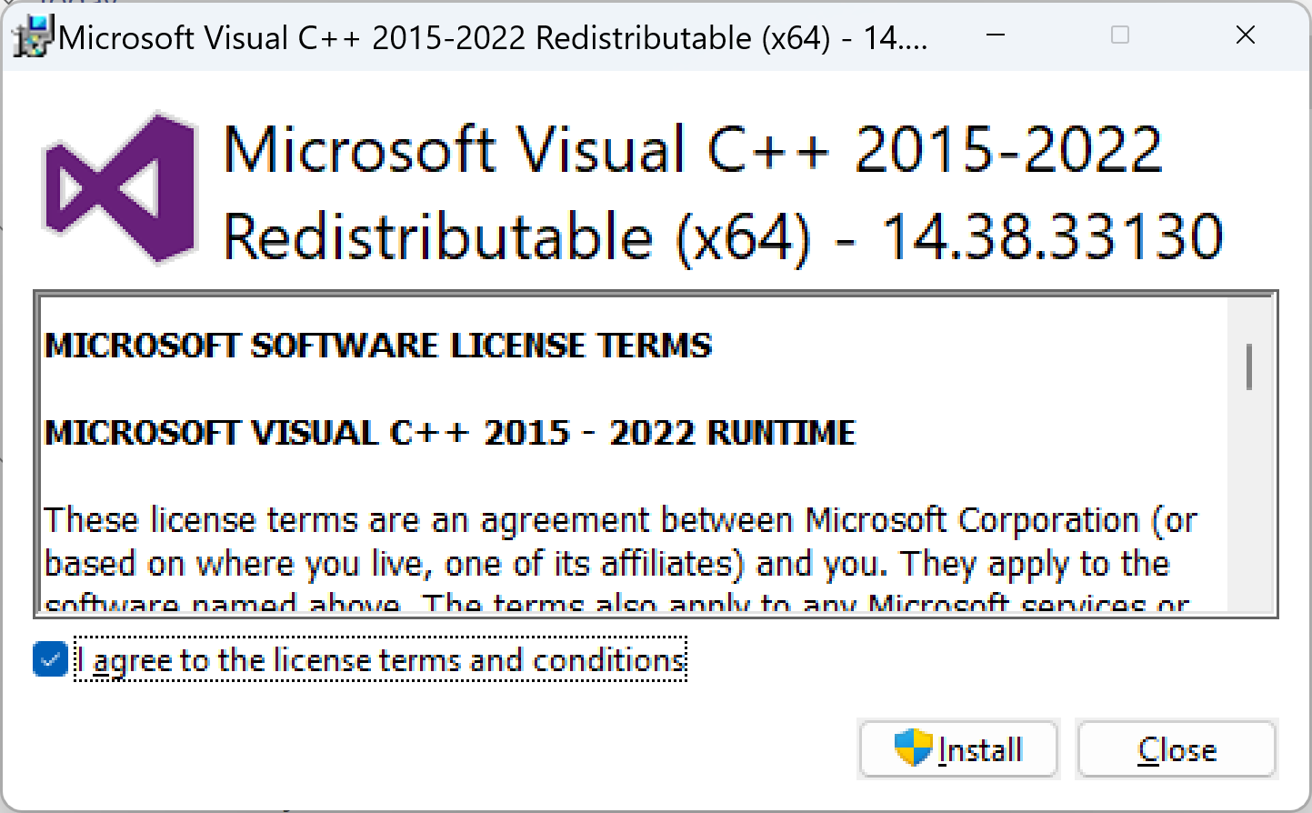
2. Install Visual C++ 2015-2022
https://learn.microsoft.com/en-us/cpp/windows/latest-supported-vc-redist

Slide 11
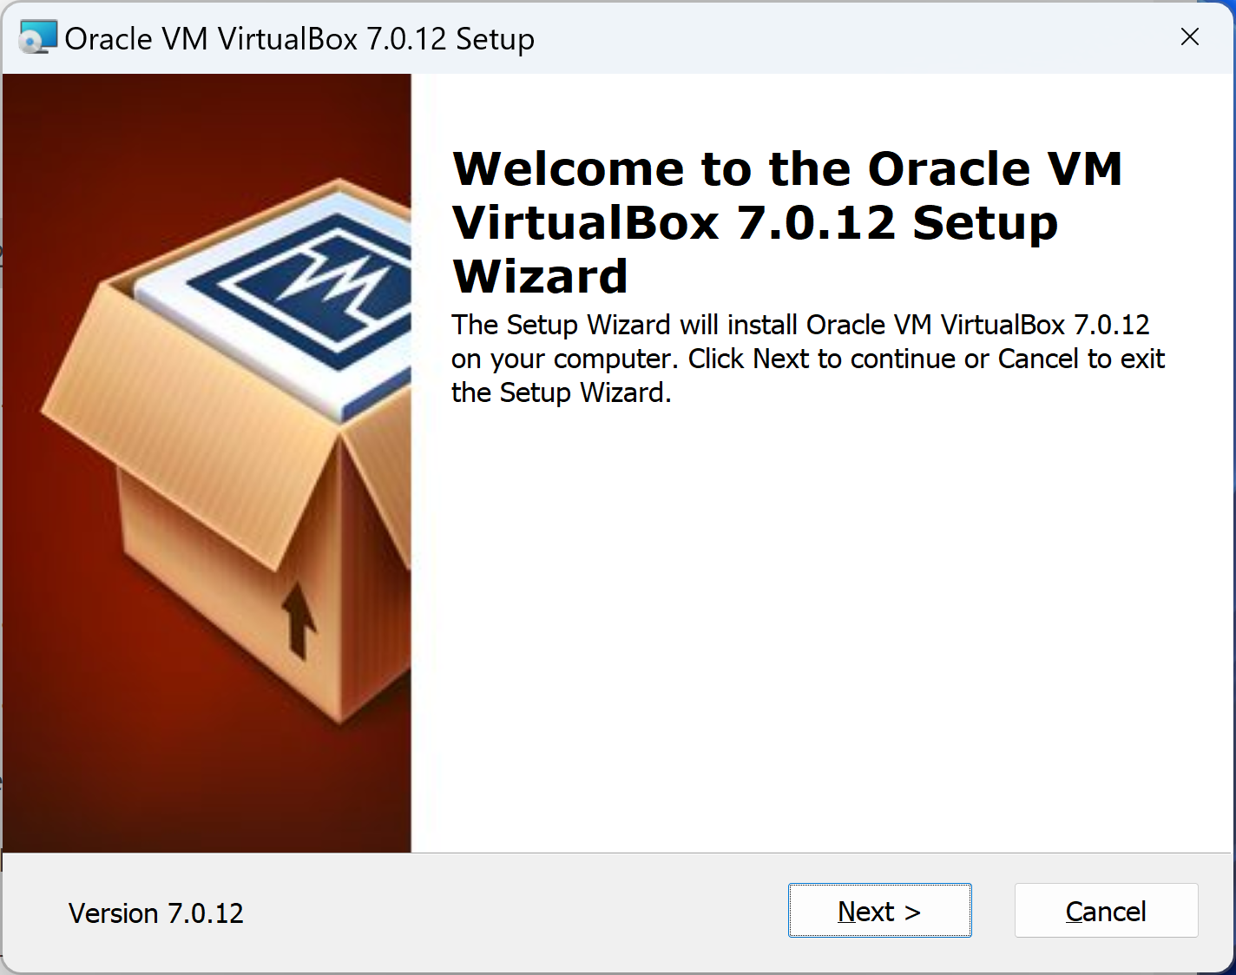
3. Install VirtualBox
http://www.virtualbox.org/wiki/Downloads

Slide 12
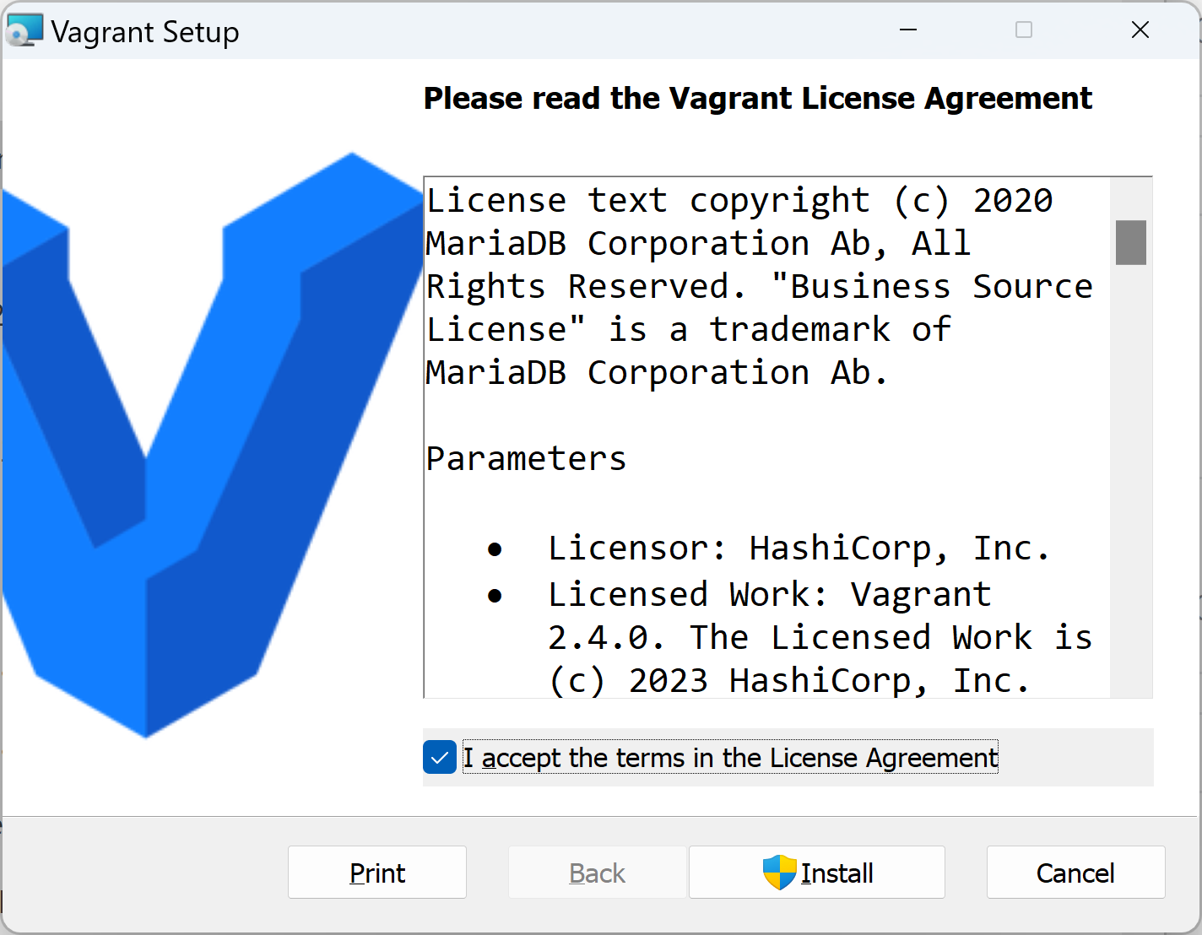
4. Install Vagrant
https://developer.hashicorp.com/vagrant/install

Slide 13
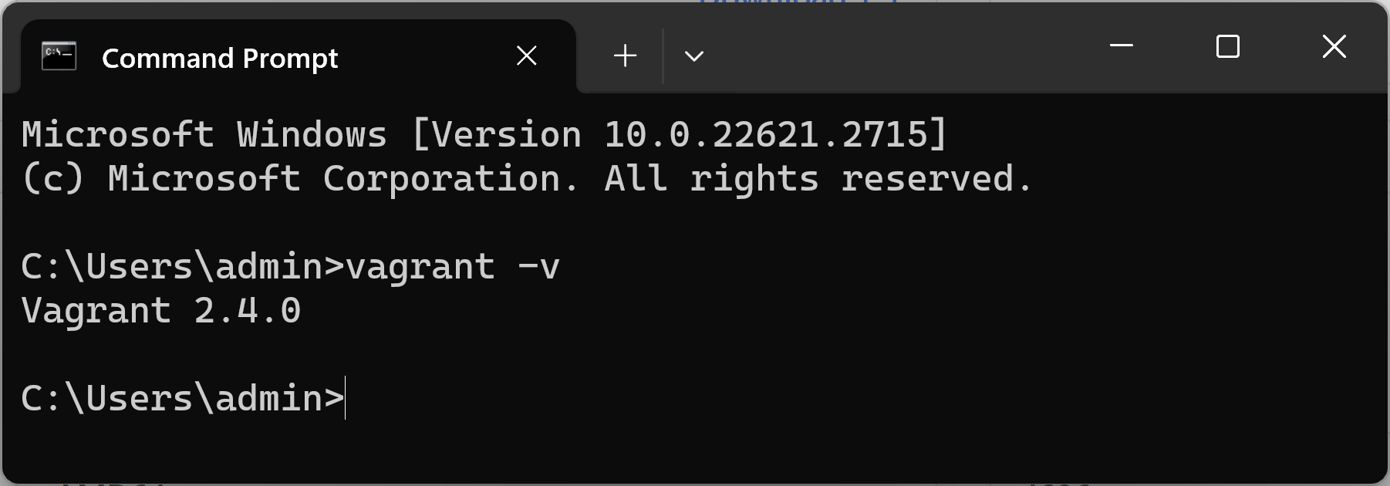
5. Verify Vagrant Installation
vagrant -v

Slide 14
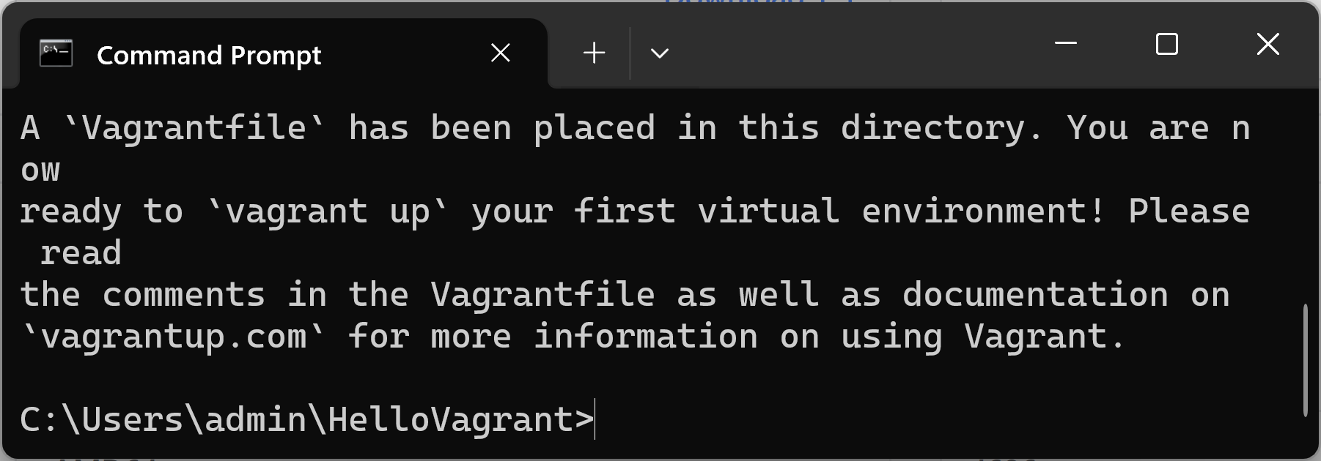
5. Download Image
mkdir HelloVagrant
cd HelloVagrant
// This command will download and configure the hashicorp/bionic64 Vagrant Box, and create a Vagrantfile in the folder.
vagrant init hashicorp/bionic64

Slide 15
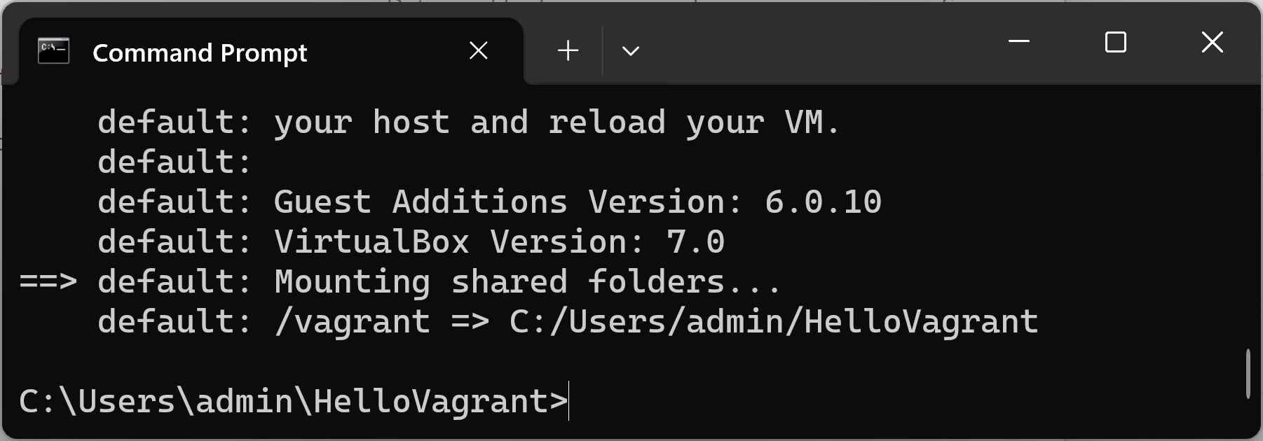
6. Start VM
vagrant up

Slide 16
7. Connect to VM
vagrant ssh
lsb_release -a

Slide 17
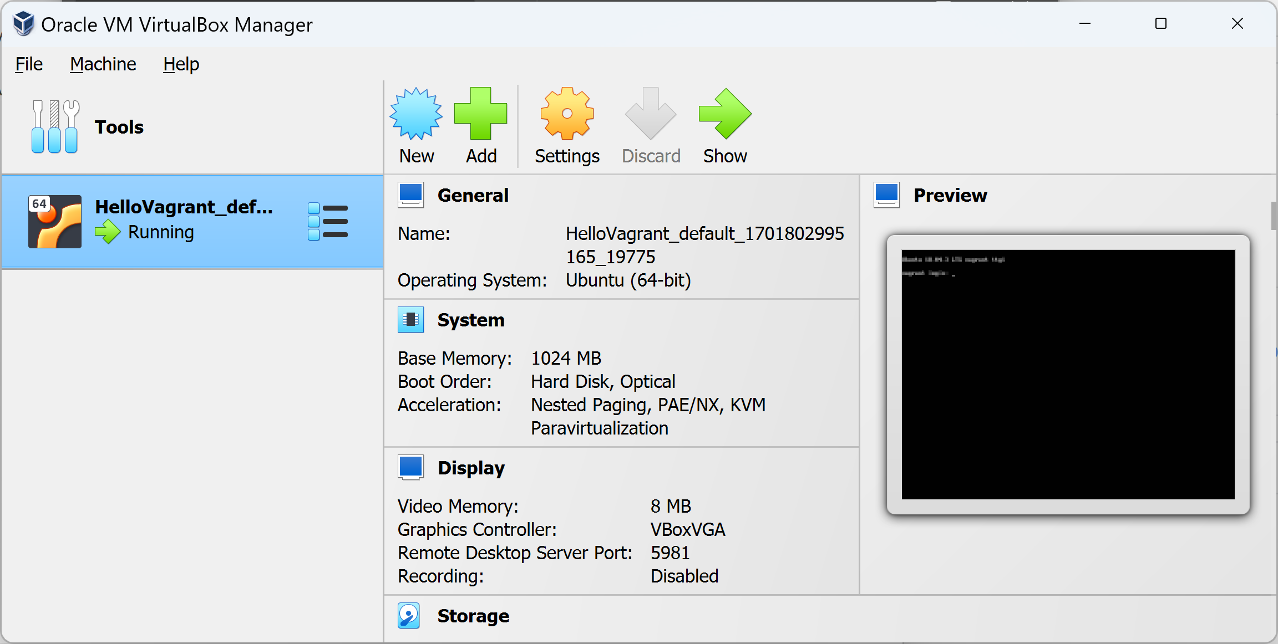
8. Review Box VM

Slide 18
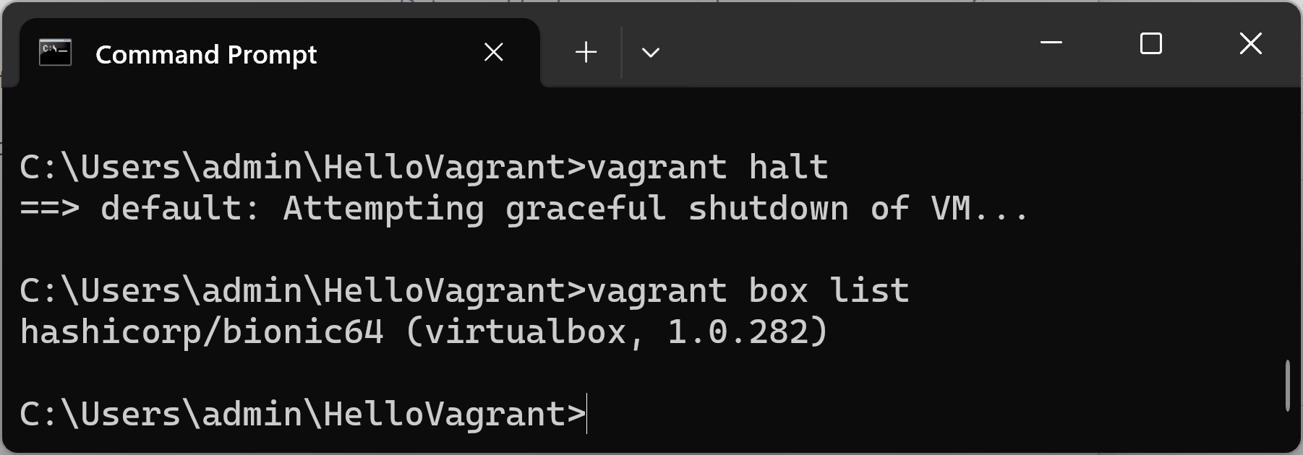
9. Shutdown VM
vagrant halt
vagrant box list

Slide 19


Slide 20
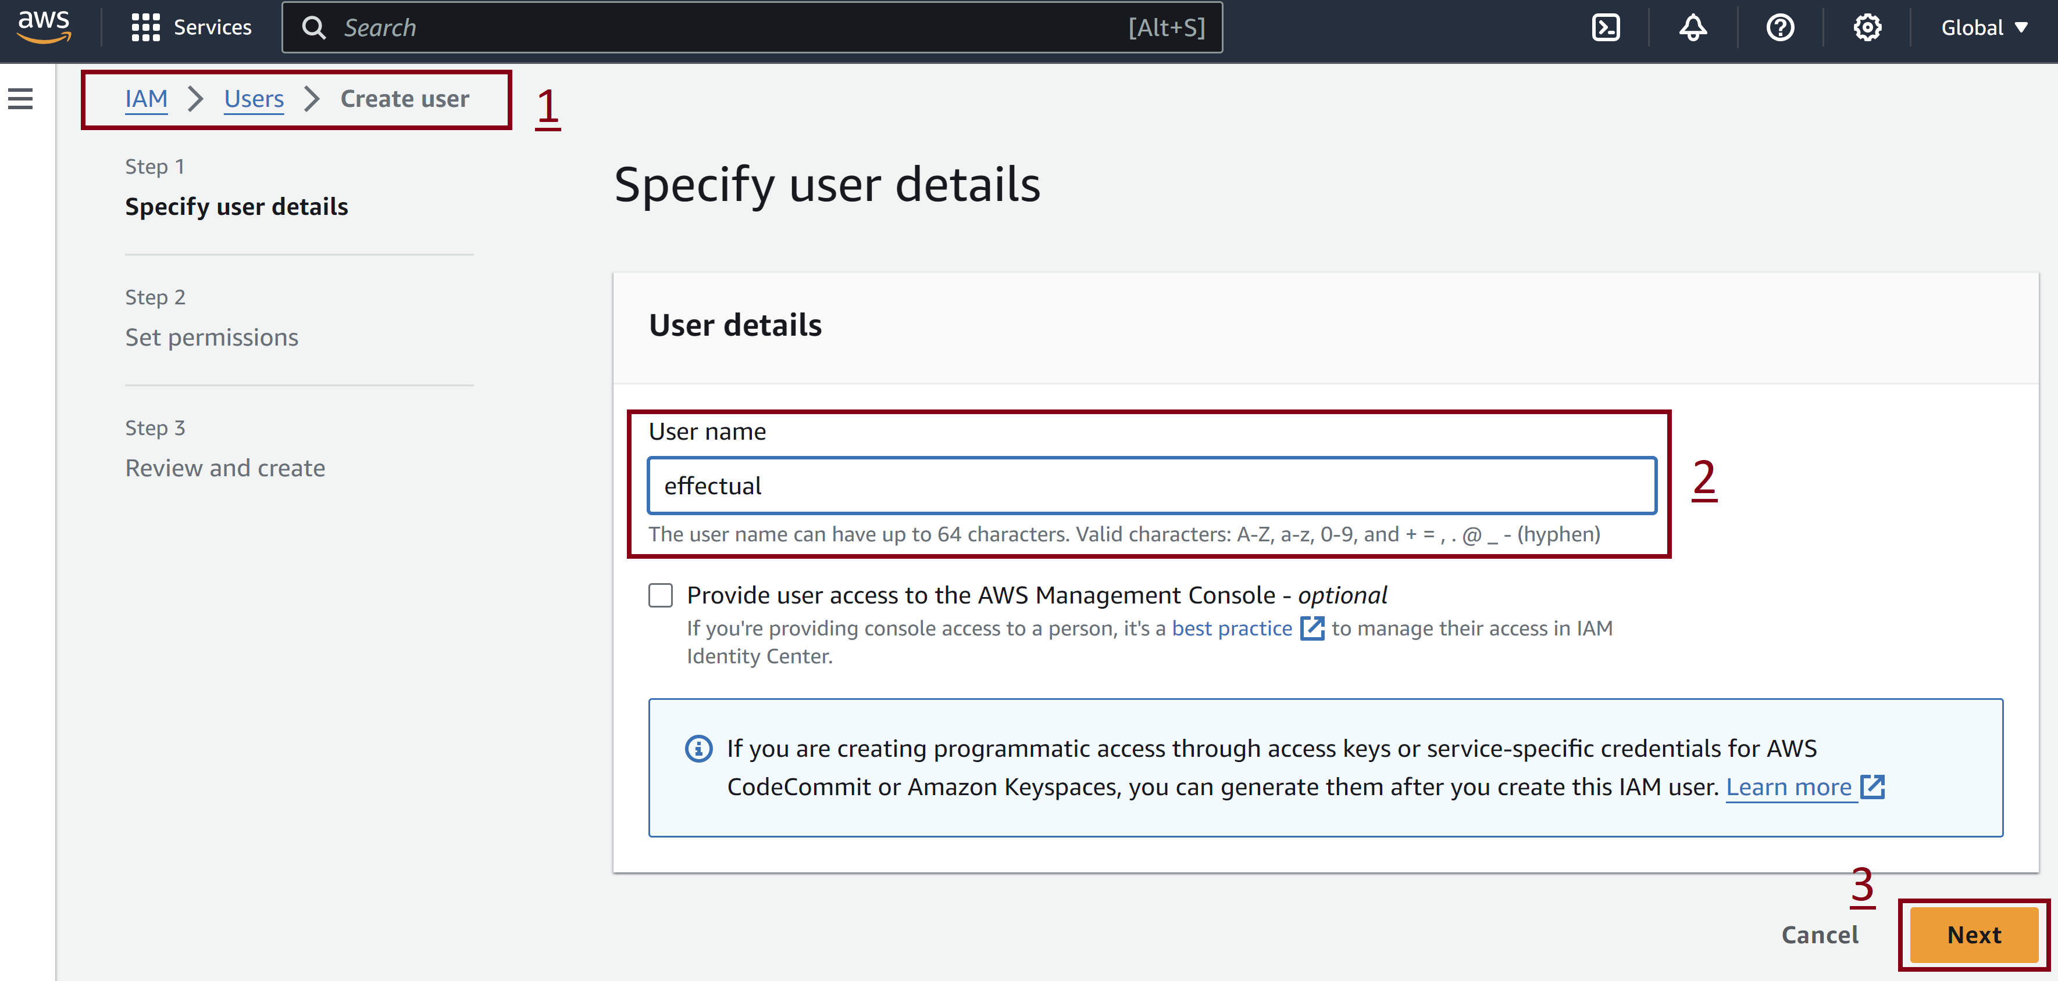
1. Create AWS User
Go to IAM → Users.

Slide 21
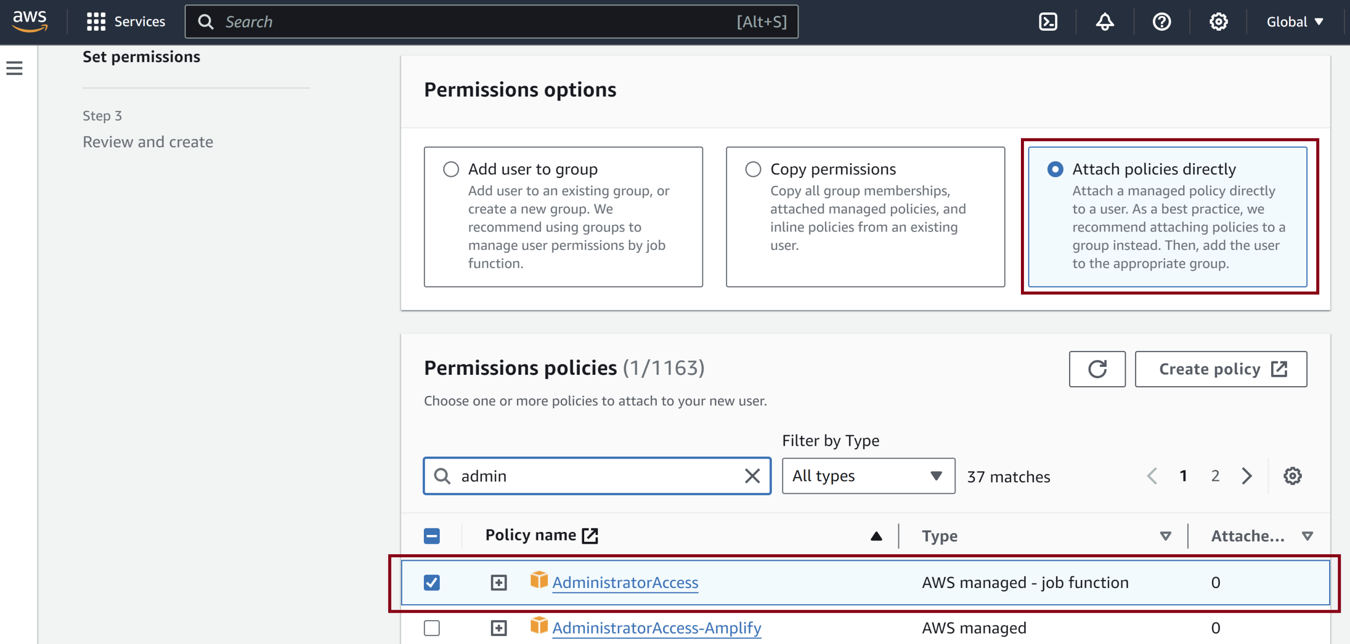
2. Attach Policies Directly
Find and select AdministratorAccess policy.

Slide 22
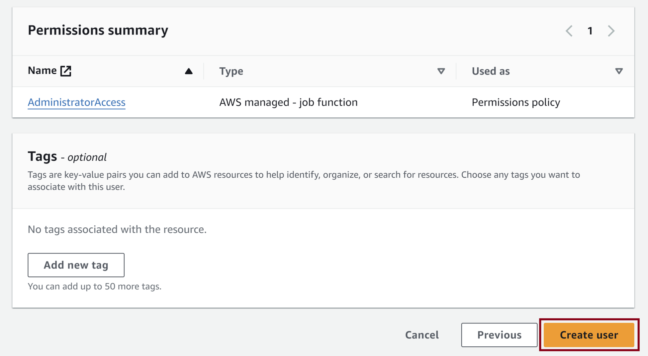
3. Confirm User Creation

Slide 23
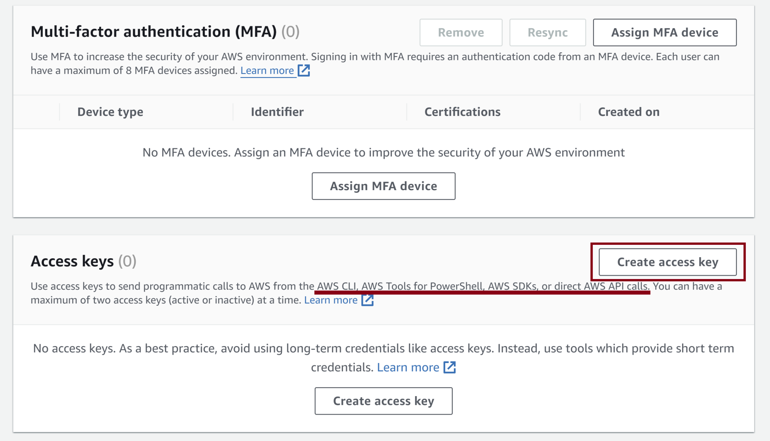
4. Create Access Key

Slide 24
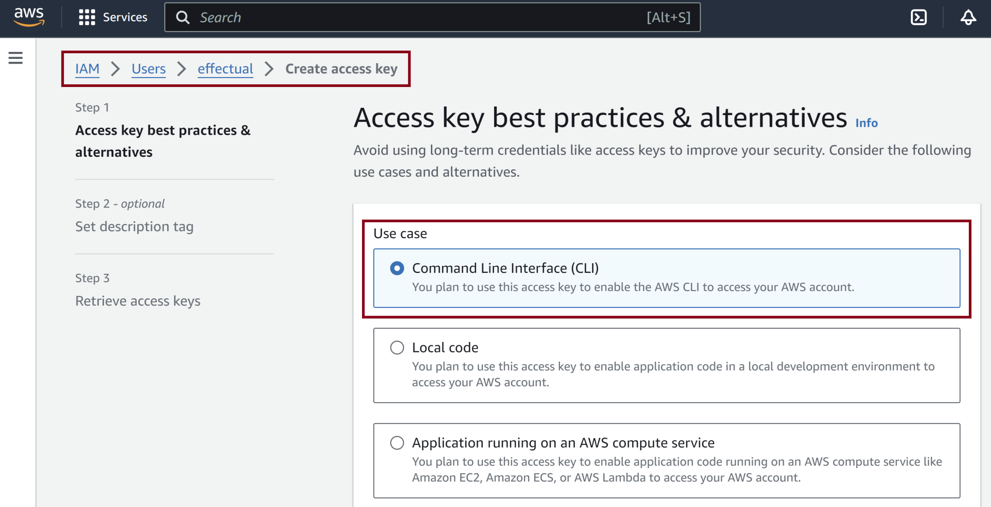
5. Select Use Case

Slide 25
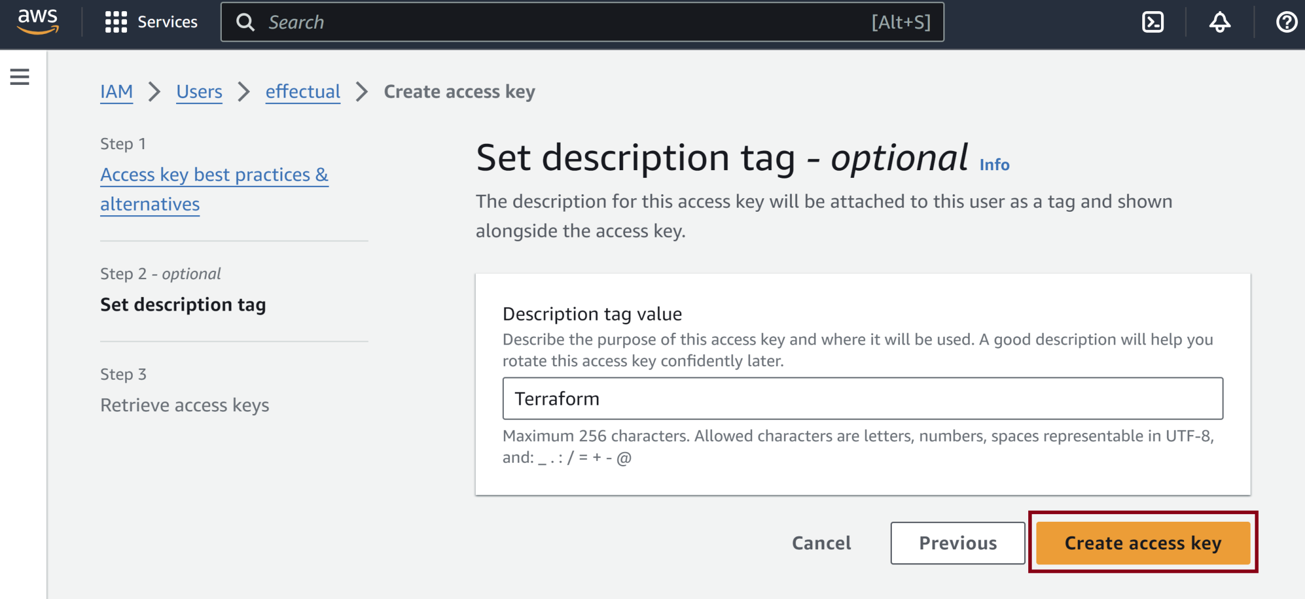
6. Confirm Access Key Creation

Slide 26
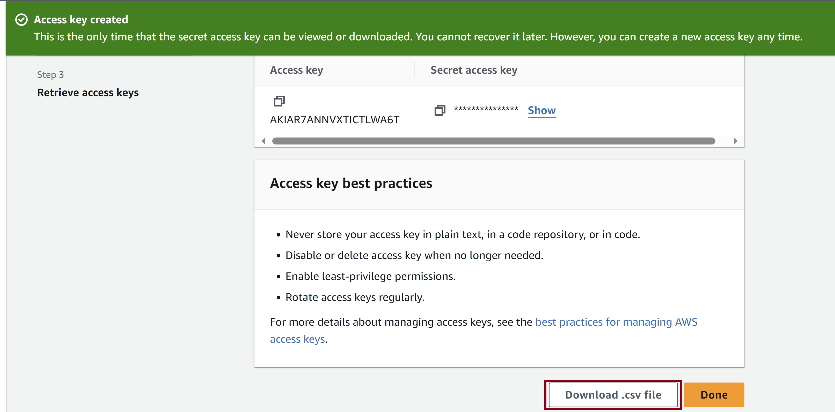
7. Download Access Key

Slide 28
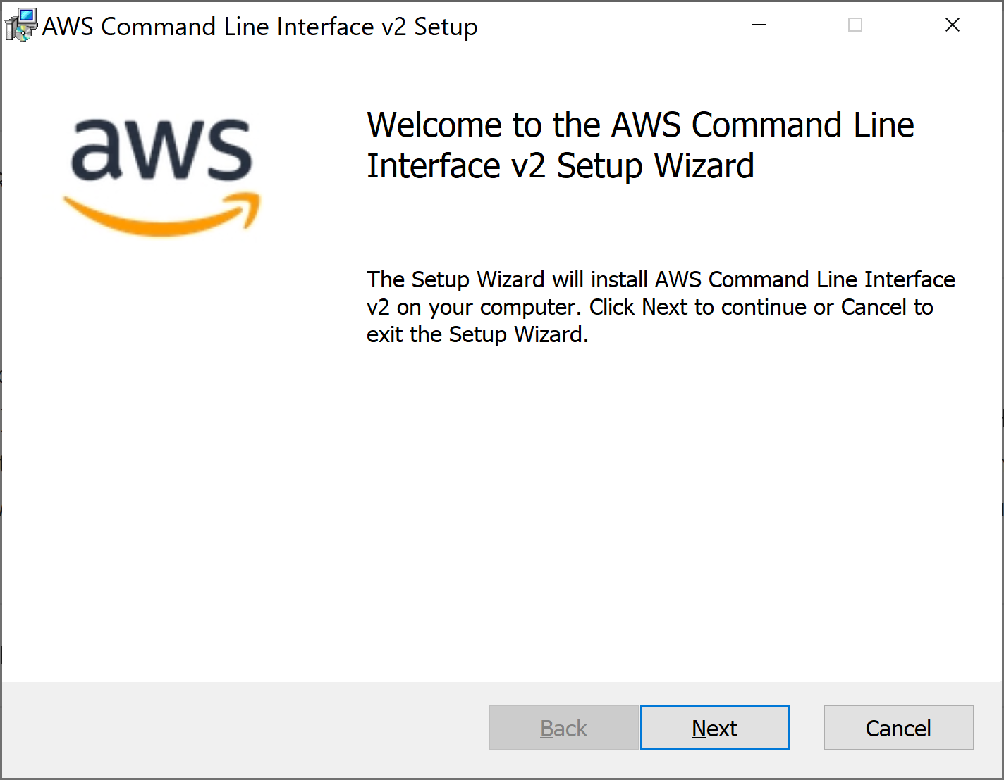
1. Install AWS CLI
https://docs.aws.amazon.com/cli/latest/userguide/getting-started-install.html
https://awscli.amazonaws.com/AWSCLIV2.msi
Add C:\Program Files\Amazon\AWSCLIV2 to SYSTEM PATH.

Slide 29
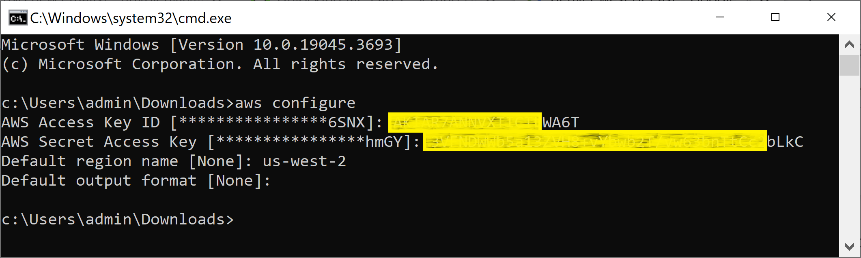
2. Configure AWS CLI
aws configure

Slide 31
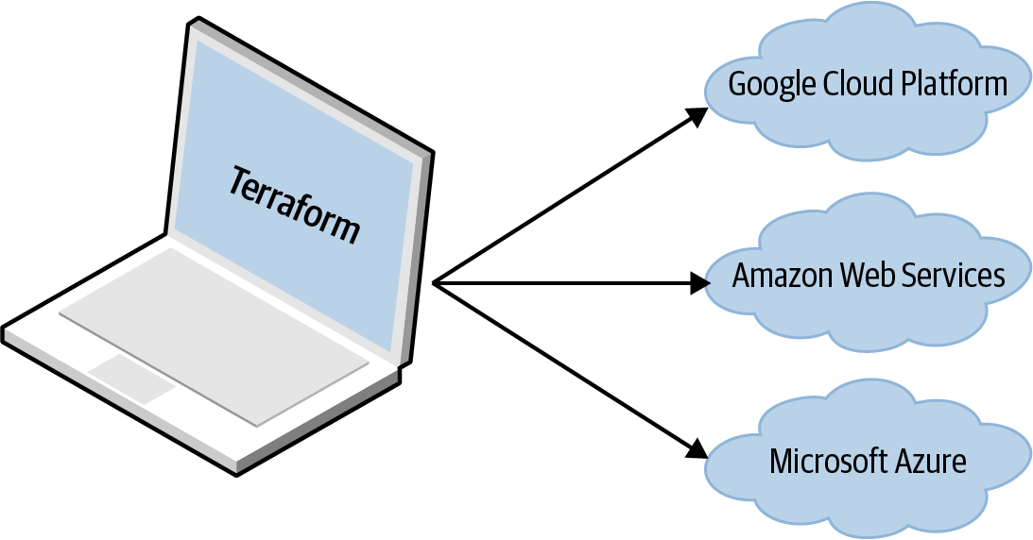
Terraform [2]
You can define your entire infrastructure—servers, databases, load balancers, network topology, and so on—in Terraform configuration files and commit those files to version control.
You then run certain Terraform commands, such as terraform apply, to deploy that infrastructure.
The terraform binary parses your code, translates it into a series of API calls to the cloud providers specified in the code, and makes those API calls as efficiently as possible on your behalf

Slide 32
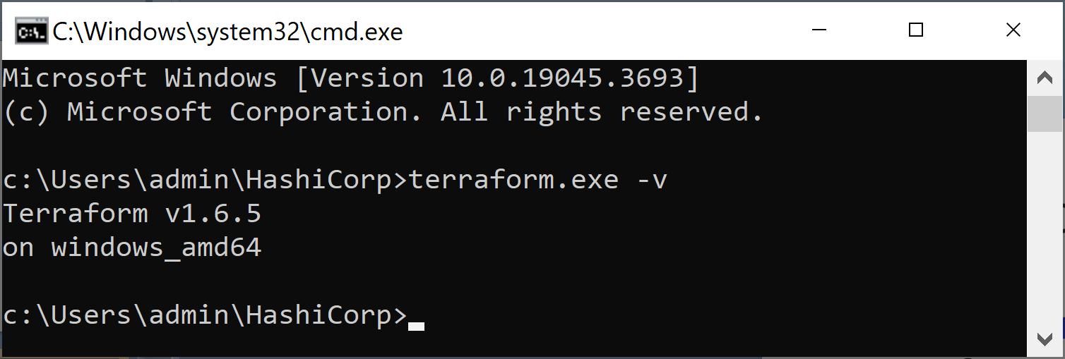
1. Download and Extract Terraform
https://developer.hashicorp.com/terraform/install
terraform -v

Slide 33
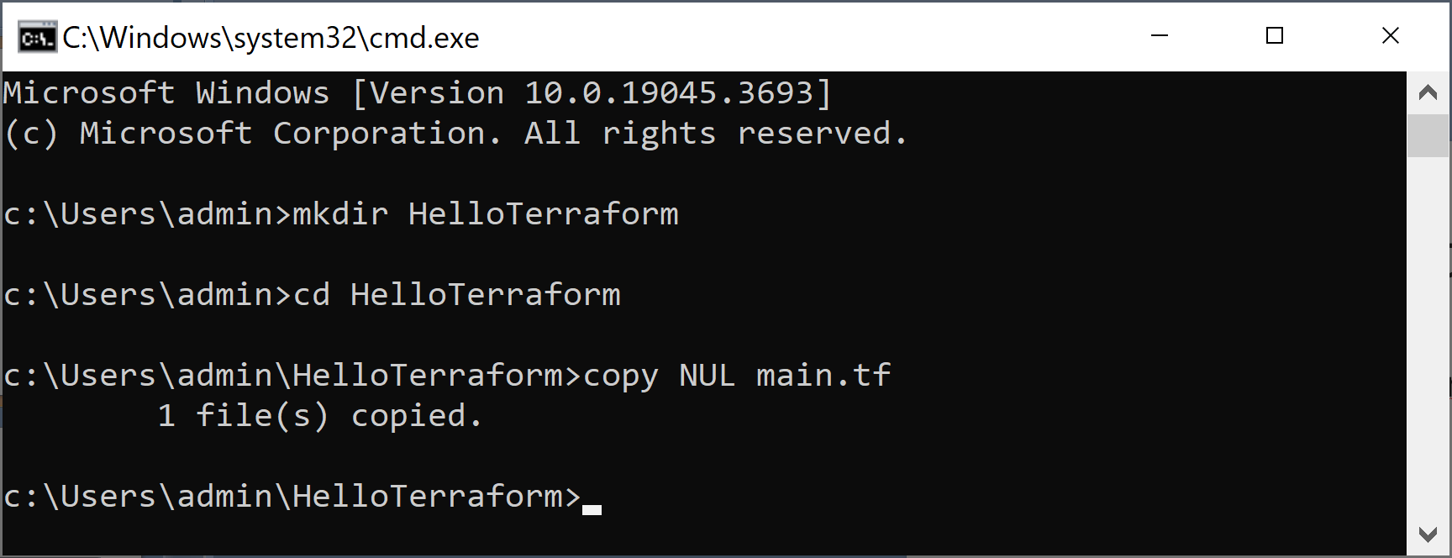
2. Create Empty main.tf
mkdir HelloTerraform
cd HelloTerraform
copy NUL main.tf

Slide 34
3. Enter Content to main.tf
provider "aws" {
region = "us-west-2"
}
# Create a VPC
resource "aws_vpc" "helloterraformvpc" {
cidr_block = "20.0.0.0/16"
}

Slide 35
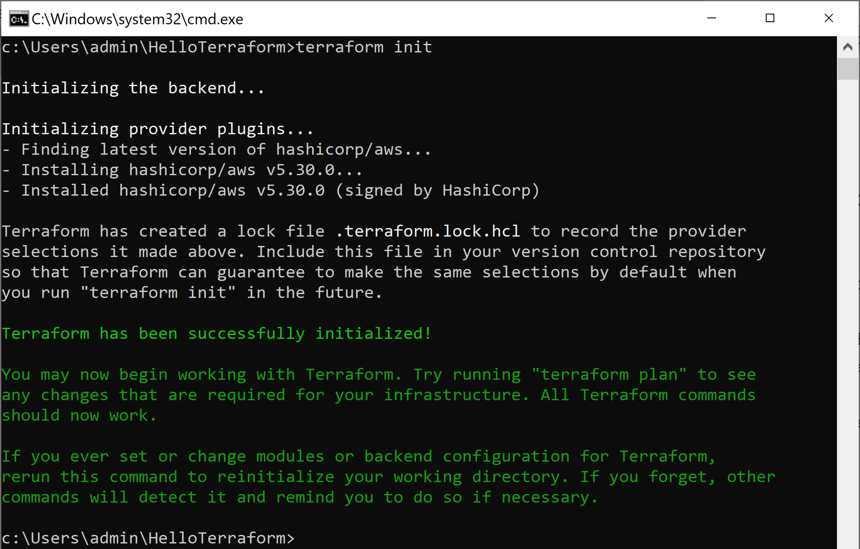
4. Download AWS Provider
terraform init

Slide 36
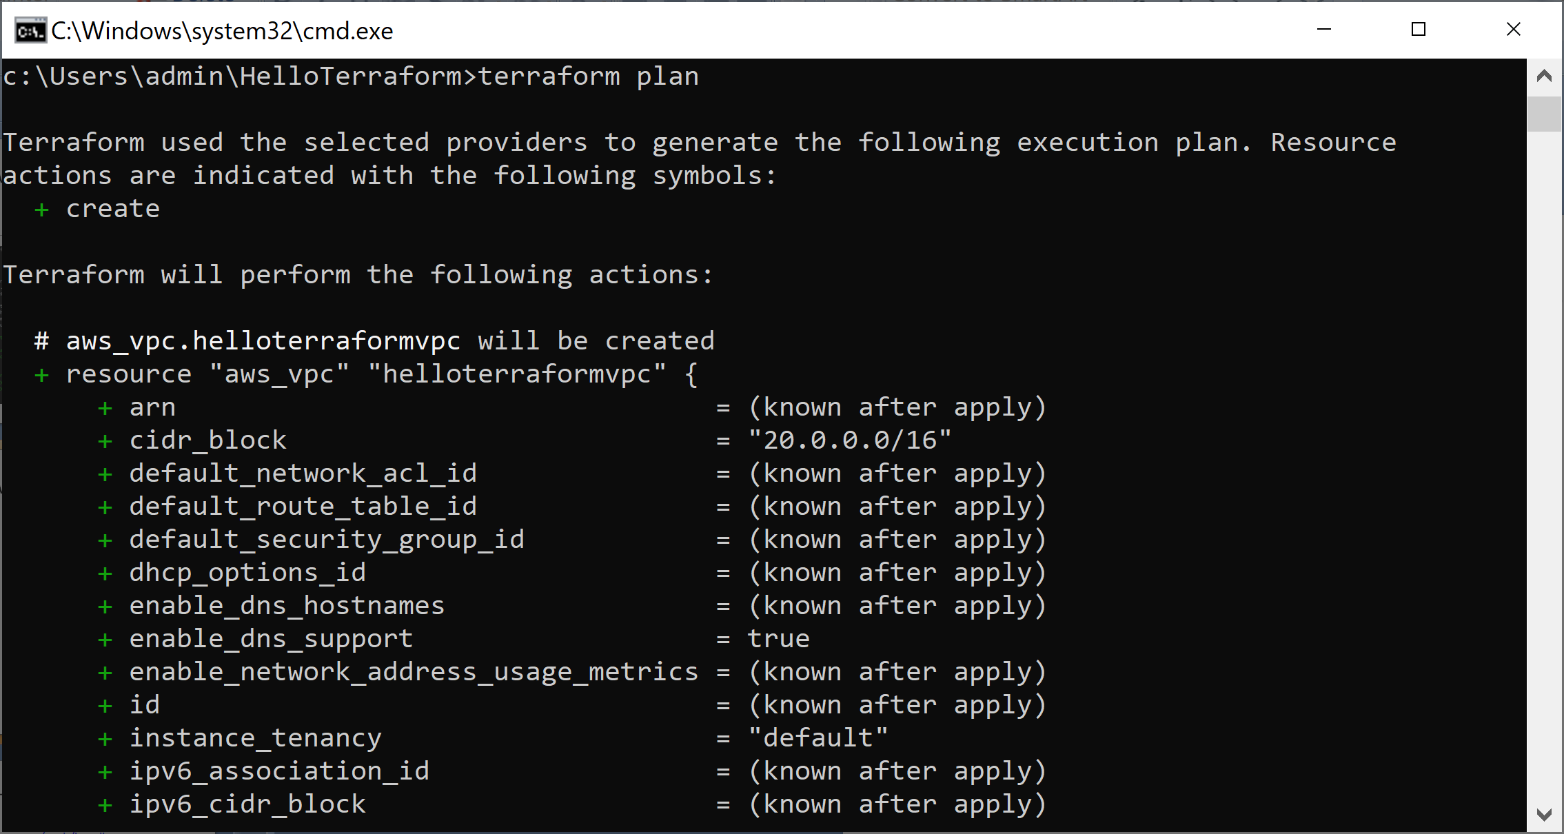
4. Create a Plan
terraform plan

Slide 37
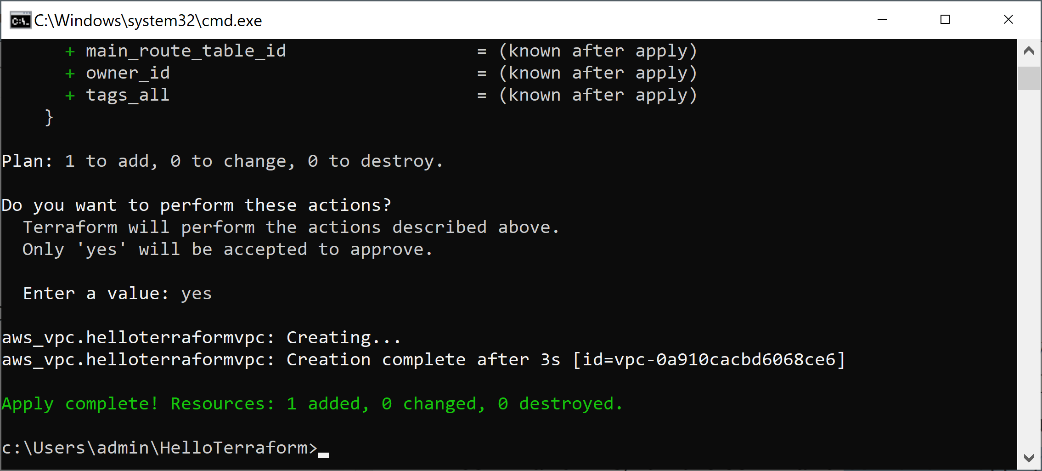
5. Apply a Plan
terraform apply

Slide 38
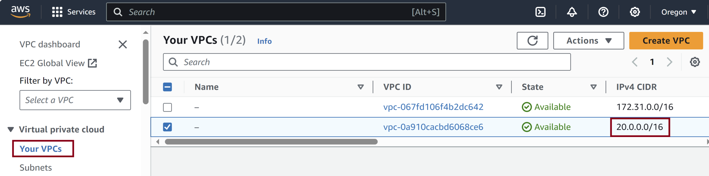
6. Review VPC

Slide 40
1. Declare Variable
provider "aws" {
region = "us-west-2"
}
variable "ip_range" {
description = "The IP Range we want to create for our VPC"
type = string
default = "20.0.0.0/16"
}
# Create a VPC
resource "aws_vpc" "helloterraformvpc" {
cidr_block = var.ip_range
}

Slide 41
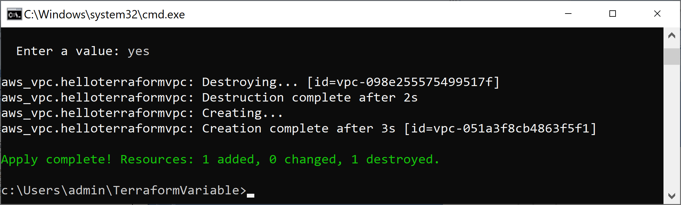
2. Apply Plan with Variable
terraform init
terraform plan
terraform apply
terraform apply -var ip_range=10.1.0.0/16

Slide 42
3. Create Single Web Server (I)
resource "aws_security_group" "example-security-group" {
name = "terraform-example-security-group"
ingress {
from_port = 8080
to_port = 8080
protocol = "tcp"
cidr_blocks = ["0.0.0.0/0"]
}
}
resource "aws_instance" "example-web-app" {
instance_type = "t2.micro"
availability_zone = "us-west-2a"
vpc_security_group_ids = [aws_security_group.example-security-group.id]

Slide 43
4. Create Single Web Server (II)
// aws_availability_zone provides details about a specific availability zone (AZ) in the current region.
ami = "ami-0efcece6bed30fd98"
// Canonical, Ubuntu, 22.04 LTS, amd64 jammy image build on 2023-09-19
user_data = <<-EOF
#!/bin/bash
echo "Hello, World" > index.html
nohup busybox httpd -f -p 8080 &
EOF
user_data_replace_on_change = true
tags = {
Name = "terraform-example"
}
}

Slide 44
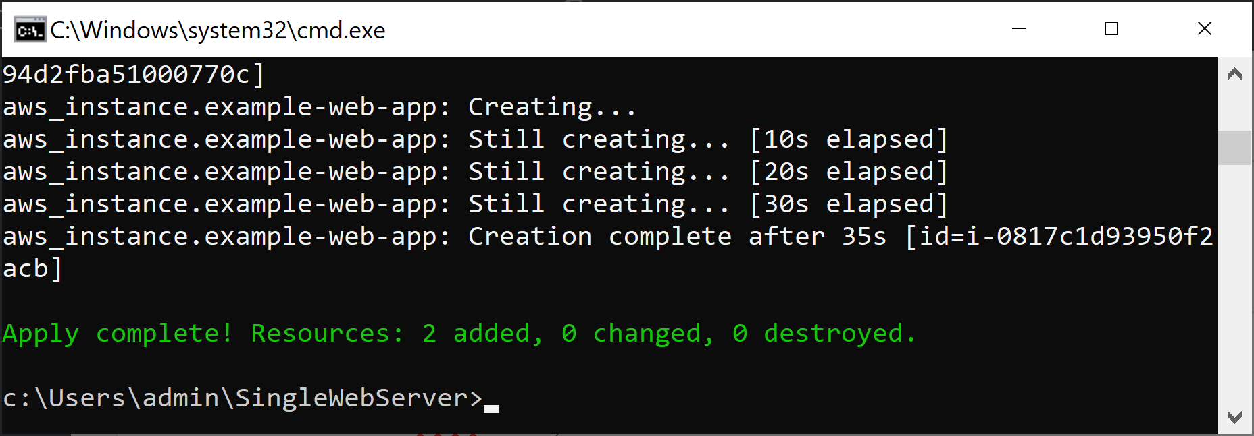
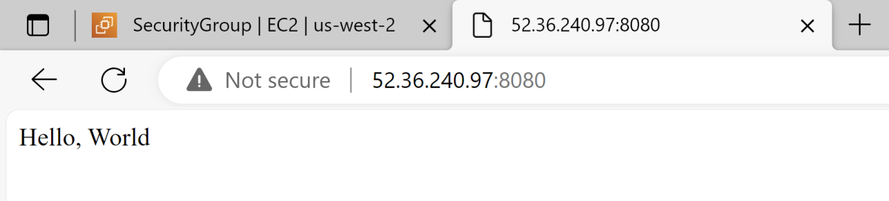
5. Create Single Web Server (III)
terraform apply

Slide 45
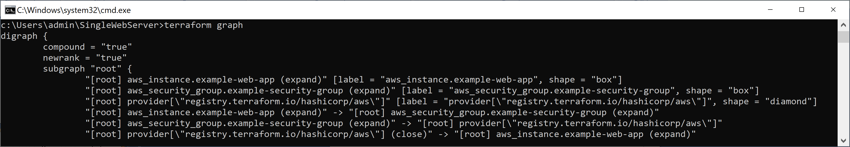
6. View Dependency Graph
terraform graph

Slide 46
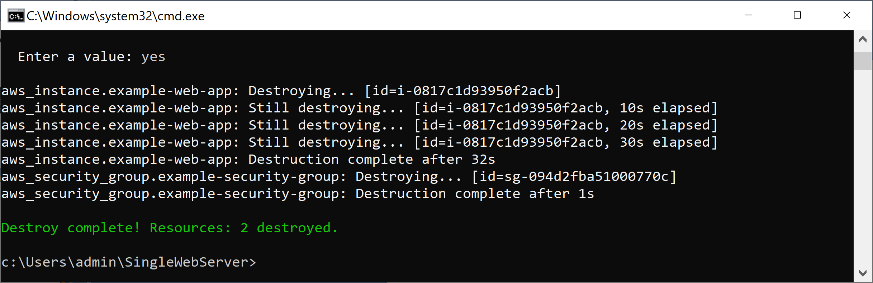
7. Destroy Resources
terraform destroy

Slide 48
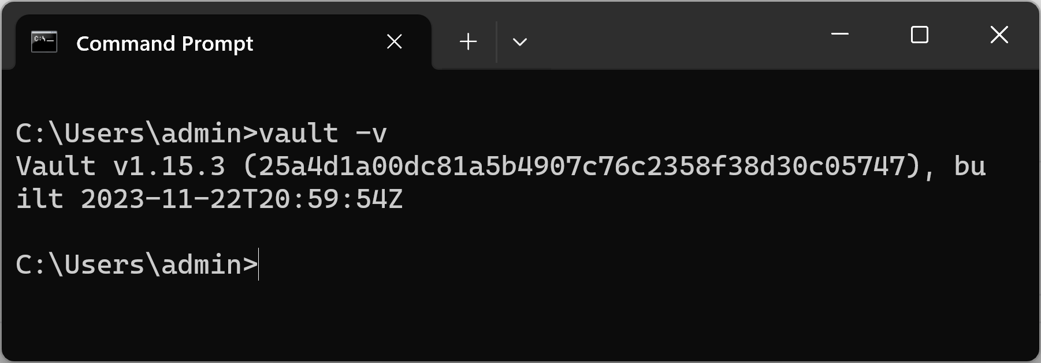
1. Download and Extract Vault
https://developer.hashicorp.com/vault/install
vault -v

Slide 49

Thank You & See You Again

